Slide 1
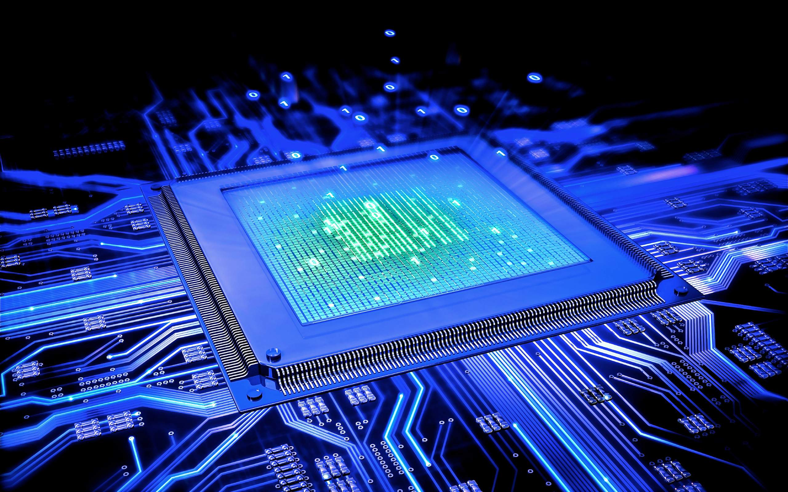
Battleport
Abdulvahid Kilic, Admir Osmanovic, Joost Zonneveld, Omar Zoundri, Shreyas Pooran
INF 1J Groep 3

Slide 2
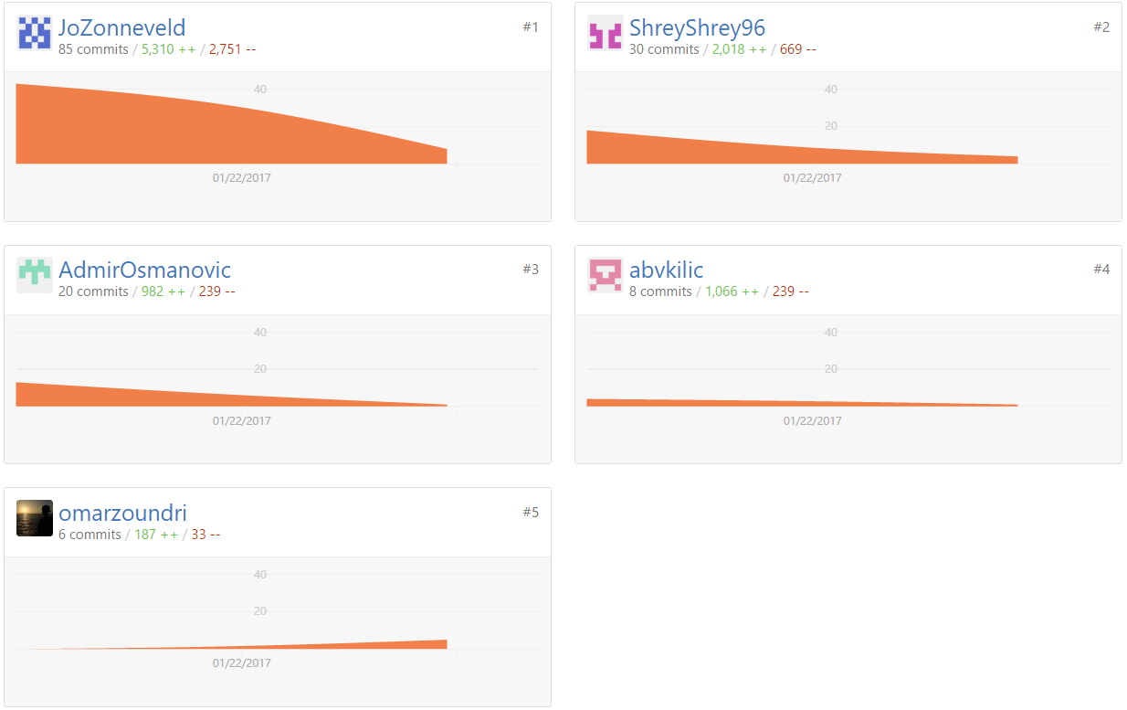
Code

Slide 3
Battleport – The Game

Slide 4

The end

